Slide 1
PFAS Overview: Regulations, Methods, Applications
December 2023
Taryn McKnight
PFAS Practice Leader
Eurofins Environment Testing

Slide 2
REGULATORY LANDSCAPE
Notes:
I won’t spend too much time on this as Ned is going to give you what I am sure is an excellent and thorough update on regulations and legislation. I just need to point out a few items that help depict the landscape in which methods are being developed and deployed.

Slide 3
Market Trends
$$$ Treatment
Class Approach
No Safe Level
Everyone is Liable
Significant investment in treatment technologies and cleanup costs
Treat all PFAS as toxic and regulate as a class
Parts Per Quadrillion (ppq) limits
Primary & secondary manufacturers, waste management, municipalities, federal government
Drivers: Legislation, Litigation, & Social Justice
Notes:
It is also helpful to be aware of the prevailing trends which are largely being driven by legislation, litigation and social justice efforts.
Because the cost of remediation remains quite high, there is significant interest in the demonstration of emerging technologies, there is a trend towards treating PFAS as a class which has a world of implications on the analytical side, the latest health advisory limits suggest no safe level for certain PFAS and with the plethora of lawsuits and the looming hazardous substances designation is appears that everyone who has ever come into contact with PFAS is potentially liable creating very high stakes for the data that are being generated.

Slide 4
Defining PFAS: Evolution of the Science
Buck et al. defines PFAS as highly fluorinated aliphatic
~200 PFAS
OECD revised definition establishes
~6M ‘Compounds’
OECD estimates
~4730 PFAS
EPA estimates
~12,000 PFAS
Number of Compounds
PFAS Sensitivity and Scope
2009
2011
2016
2018
2019-2020
2021 - 2022
Reporting
Limits
U.S. EPA Provisional DW Health Advisory:
PFOA - 400 ppt PFOS - 200 ppt
U.S. EPA Final DW Health Advisory: PFOA - 70 ppt
PFOS - 70 ppt
Various U.S. States: PFOA/PFOS 5-20 ppt in DW
U.S. EPA Interim DW Health Advisory: PFOA - 4 ppq
PFOS - 20 ppq
100,000X increase in sensitivity
Source – PubChem Classification Browser (nih.gov)
Notes:
From those trends, one of the more significant challenges we are facing, is this growing debate within the scientific community about the mere definition of a PFAS. Especially if we are going to treat PFAS as a class, it is critical to know what it is we are trying to clean up or comply with.
About 10 years ago we used a working definition that included about 200 compounds. In 2023 we have a variety of definitions ranging from thousands to millions of substances that qualify as a PFAS.
Of course, all of this debate over the broadening definition of PFAS is transpiring against the backdrop of ever-decreasing human health risk levels.

Slide 5
VARIED APPROACH
UCMR5
NPDWR
CERCLA
RCRA
TSCA 8(a)(7)
NPDES
CCL5
TRI
Wastewater
40 PFAS/AOF
Draft 1633/Draft 1621
PWS
29 PFAS
PWS
PFOA & PFOS @ 4ppt
HI for PFNA, PFHxS, PFBS, HFPO-DA
Articles & Materials
PFAS as a Class
~1462
PWS
PFAS as a Class
~10,239
Emissions/Disposal
189 PFAS
Hazardous Substance Designation
PFOA & PFOS
Hazardous Constituents Designation
PFOA, PFOS, PFBS, HFPO-DA
5
Notes:
At the federal level this graphic depicts the myriad of regulations in force or proposed, and the vastly different approaches depending upon the program. These approaches range from addressing PFOA and PFOS only, or just a handful of PFAS, as is the case with the CERCLA and RCRA designations or the drinking water efforts with UCMR5 or the NPDWR, to addressing a list of 40 PFAS in wastewater or 189 PFAS under TRI, all the way up to addressing PFAS as a class but with varying definitions so just how many PFAS are part of that class definition will vary.

Slide 6
2023 NATIONAL DEFENSE AUTHORIZATION ACT (NDAA)
Sec. 341
Sec. 323. Destruction of materials containing PFAS not requiring incineration.
One year to develop guidance on best methods for destruction and disposal with an emphasis on alternatives to incineration.
Sec. 344. Standards for response actions with respect to PFAS contamination.
Any response action to address PFAS contamination from DoD activities must meet or exceed the most stringent of the following standards:
a state standard
a federal standard
a health advisory
This applies to the following PFAS: PFNA, PFOA, PFHxA, PFOS, PFHxS, PFBS, PFHpA, PFDA, and Fluorotelomer sulfonamide betaine
Sec. 5883. Clean Water Act effluent limitations guidelines and standards and water quality criteria for PFAS.
*Will discuss details in under the Effluent Limitation Guidelines slide.
Sec. 5110. Registry of individuals exposed to PFAS on military installations
One year to establish a registry for eligible individuals (someone who served or is serving in the Armed Forces at a military installation where AFFF was used) who may have been exposed to PFAS due to an AFFF release.
Prizes for development of non-PFAS-containing turnout gear
Sec. 345
Procurement of certain items containing PFOS or PFOA
Sec. 375
Reports relating to AFFF substitutes and PFAS contamination at priority sites
Sec. 5803
Expansion of CDC multi-site study of PFAS contamination
Sec. 5810
DoD School PFAS testing and filtration program
https://www.govinfo.gov/app/details/BILLS-117s1605enr
Notes:
The National Defense Authorization Act or NDAA has become a preferred tool for passing PFAS legislation and this year’s was no different.
Whether the work you do falls under the DoD’s program or not, Congress manages to pass several provisions each year that are well outside the scope of the DOD in this bill.
There are two in particular that I want to highlight for you.
First was this requirement for the DoD to follow the strictest of the following standards for response actions, a state standard, a federal standard, or a health advisory.
Of course a few states have standards, but we do not have a federal DW standard yet.
I was very curious to see how the health advisory would be handled but it appears the interim status for PFOA and PFOS may be a loophole because in a DoD memo dated July 2023, the DoD confirmed it is using the 70ppt advisory limit until such time a federal standard is promulgated.
Then there was this unusual Clean Water Act requirement essentially directing the EPA to address PFAS under the CWA with prescriptive requirements. I’ll tell you more about these when we get to the topic of wastewater.

Slide 7
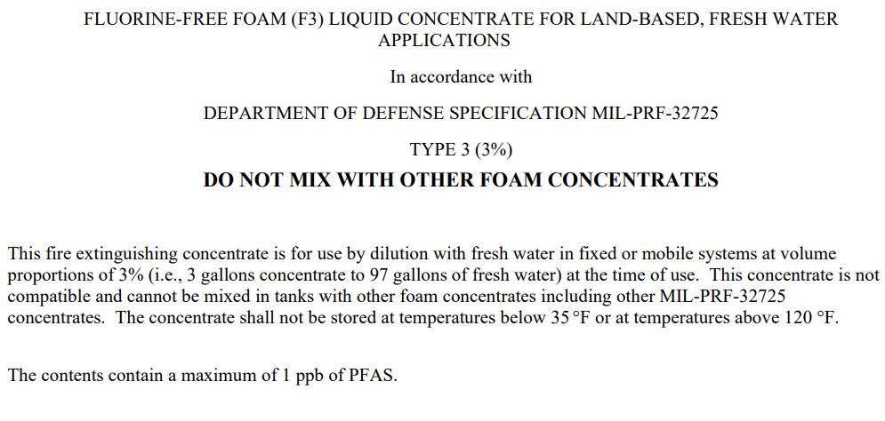
https://aboutblaw.com/6pN
Notes:
Other developments that came out of Congressional mandates include a new MILSPEC for Fluorine Free Foams. This was published in Jan of this year.
This specification is intended for delivery systems and equipment for extinguishing land-based liquid fuel fires.
The requirements include using a lab that is DoD ELAP accredited specifically for AFFF by Draft method 1633. The challenge here is that Draft Method 1633 was not written or validated for AFFF product.
Also, the sum of discrete PFAS may not exceed 1ppb which would be very challenging to achieve in a complex matrix such as this, using the prescribed method.
As a follow up to this action, NAVSEA added the first F3s to the qualified products list in September.
However, it looks like the Defense secretary will likely seek to invoke statutory waivers that would give the military as much as two years to comply with a congressional mandate that goes into effect next Oct. 1 barring use of PFAS-containing firefighting foam, due to the lengthy time it will take to transition its equipment to a replacement foam and the struggle to find suitable foams for all applications.
The Federal Aviation Administration (FAA) has notified airports that they may begin using these PFAS-free firefighting foams that meet the new mil-spec, although airports are not required to use the new foam.

Slide 8
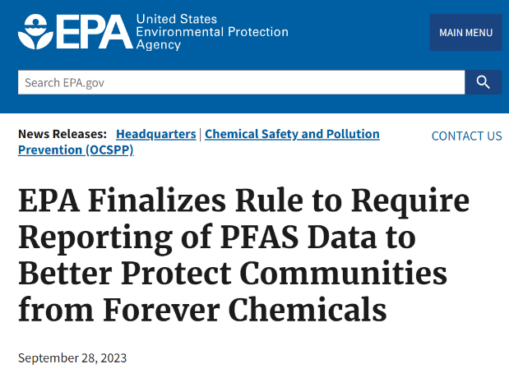
TSCA SECTION 8(a)(7)
Rule to Require Reporting on PFAS Manufactured in the United States
T
S
C
A
EPA to require certain persons that manufacture (including import) or have manufactured these chemical substances in any year since January 1, 2011, to electronically report information regarding PFAS uses, production volumes, disposal, exposures, and hazards.
Toxic
Substances
Control
Act
https://www.epa.gov/newsreleases/epa-finalizes-rule-require-reporting-pfas-data-better-protect-communities-forever
https://www.epa.gov/assessing-and-managing-chemicals-under-tsca/tsca-section-8a7-reporting-and-recordkeeping
Notes:
Continuing on with obligations under the NDAA, although this time from the 2020 NDAA, the EPA proposed Reporting and Recordkeeping Requirements for PFAS under TSCA. This was back in June of 2021.
After a long delay due to the need to convene a Small Business Advocacy Review (SBAR) Panel,
as of Sept 28th, the rule has been finalized.
Those who have manufactured or imported PFAS in any year since Jan 2011 must report information regarding uses, production volumes by category of use, byproducts, environmental and health effects, workers exposure, and disposal.
The new rule notably extends PFAS reporting to the manufacturers not only of PFAS but also of articles that use PFAS in their manufacturing process and there are no de minimis exemptions.
According to the agency, the rule is expected to provide the EPA with comprehensive data on more than 1,364 PFAS.

Slide 9
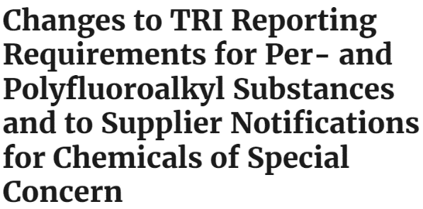
A
Toxics Release Inventory (TRI)
Act
Rule to remove de minimis exemptions
EPA classifies PFAS compounds on the TRI as “chemicals of special concern.” Such classification eliminates the availability of the de minimis exemption to TRI reporting, known as Section 313 reporting, for both manufacturers and suppliers as well as removes the exemption under the Supplier Notification Requirements.
E
P
C
R
Emergency
Planning
Community
Right-to-know
https://www.federalregister.gov/documents/2023/10/31/2023-23413/changes-to-reporting-requirements-for-per--and-polyfluoroalkyl-substances-and-to-supplier
Notes:
In a similar vein, EPA has updated the Toxics Release Inventory or TRI rule to address PFAS reporting obligations as well.
Facilities across industry sectors must report annually how much of each chemical is released to the environment.
189 PFAS with a threshold of 100 pounds per year are currently subject to this reporting rule.
The new rule classifies PFAS as “chemicals of special concern”, removing a longstanding exemption that allowed facilities to avoid reporting PFAS chemicals used in minimal concentrations.
So companies can no longer use the de minimis exemption to disregard chemicals with concentrations below 1% in mixtures or products.
Furthermore, the de minimis exemption for Supplier Notification Requirements has also been eliminated.
Which means suppliers can no longer exclude purchaser notifications about mixtures or trade name products with PFAS, even if they makeup less than 1% of the mixture.
EPA reasoned that the elimination of this exemption is necessary in light of the surprisingly low number of PFAS-related submissions made for the 2021 and 2022 reporting cycles.
This rule goes into effect for the 2024 reporting year which we will have to wait to see the results of this change until July of 2025 when those reports are due.
Interestingly, the final rule preserves the TRI article exemption, limiting compliance obligations for manufacturers of parts and finished products.
This contrasts with the TSCA reporting rule I just mentioned which did not include an article exemption.

Slide 10
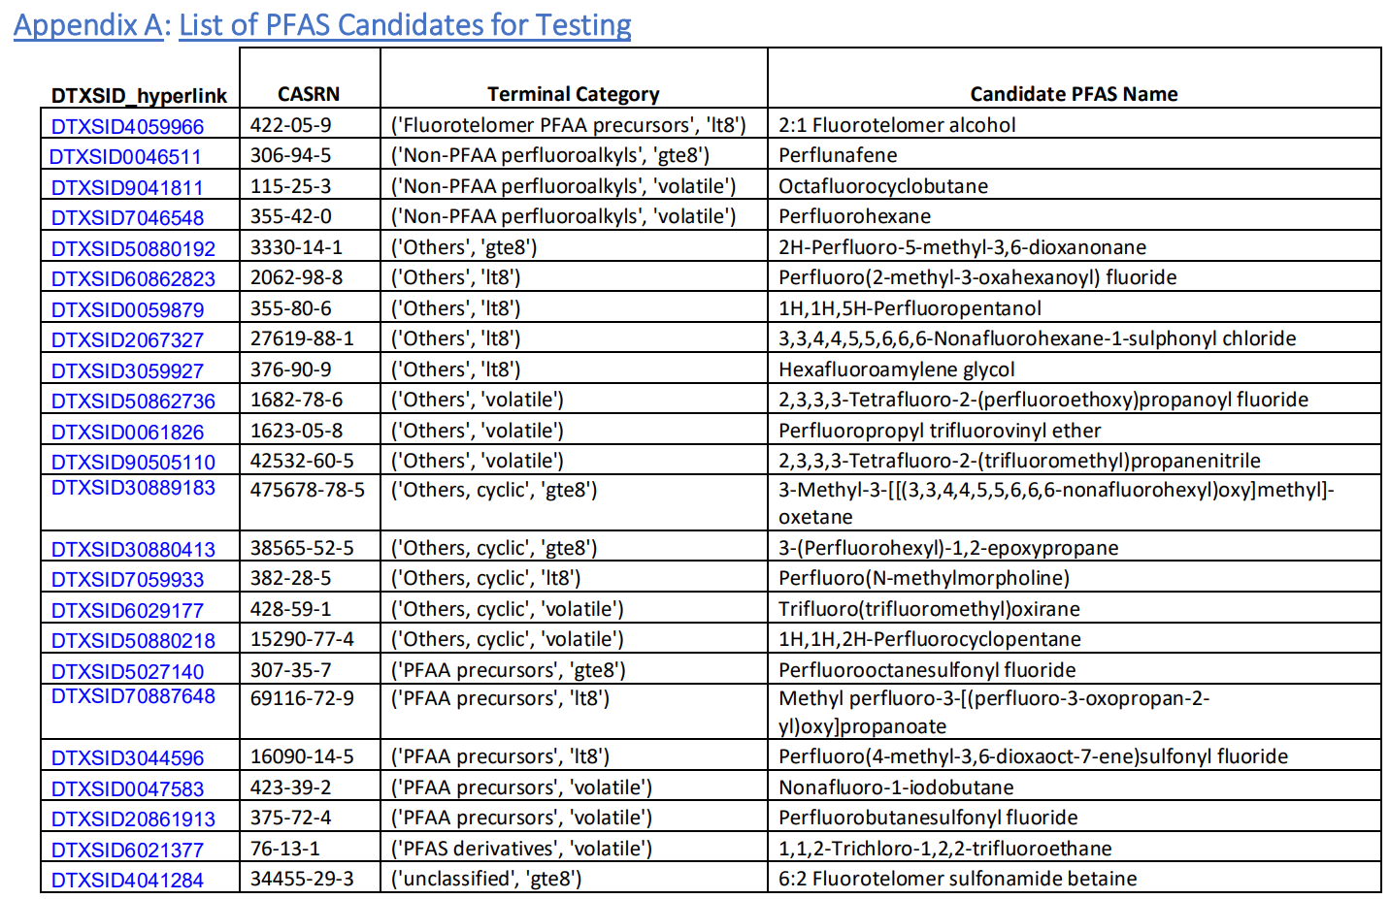
National PFAS Testing Strategy
Appendix A: List of PFAS Candidates for Testing
10
https://www.epa.gov/system/files/documents/2021-10/pfas-natl-test-strategy.pdf
https://www.regulations.gov/document/EPA-HQ-OPPT-2021-0910-0001
Notes:
EPA TSCA also manages the National PFAS Testing Strategy where they developed categories of PFAS based on information about similarities in structure, physical-chemical properties, and existing test data on the toxicity of PFAS.
The Agency is looking to obtain critical information on more than 2,000 similar PFAS that fall within set categories.
This is a snapshot of the candidate list from the National PFAS Testing Strategy document.
Only 24 PFAS had identifiable manufacturers to whom EPA could issue a test order so that was a limiting factor.
So far, they have issued 3 test orders, two at the beginning of the year and one this August. Two of the three are GenX related, HFPO and HFPO-DAF.
The companies in receipt of these test orders are required to conduct a series of tiered tests, with the first block of results due 446 days after the order takes effect. That data “will inform the decision as to which additional tests are necessary so this is not a instant gratification sort of endeavor.

Slide 11
WASTEWATER
Notes:
Moving along to wastewater now….

Slide 12
Effluent Guidelines Program
Program Plan 15
Propose limits on PFAS for the chemical, plastics, and synthetic fiber manufacturers (NDAA June 2024)
Expand Textiles study (NDAA June 2025)
Revise ELGs for the Landfills category (NDAA June 2025)
Not pursuing further action for the Electrical and Electronic Components Category (NDAA June 2025)
Will monitor PFAS use and discharges from the Pulp, Paper, and Paperboard Category and Airports
Leather tanning/finishing, paint formulating, and plastics molding categories (NDAA December 2026)
2023 NDAA, SEC. 5883. CLEAN WATER ACT EFFLUENT LIMITATIONS GUIDELINES
The Administrator shall publish in the Federal Register effluent limitations guidelines and standards for priority industry categories, not later than the following dates…
https://www.epa.gov/system/files/documents/2023-01/11143_ELG%20Plan%2015_508.pdf#page=48
https://www.epa.gov/system/files/documents/2023-01/11143_ELG%20Plan%2015_508.pdf
Notes:
On January 20, 2023 the EPA released the final Effluent Guidelines Program Plan 15.
EPA stated it would not pursue further action for various categories but would continue to monitor these categories moving forward.
However, remember the 2023 NDAA included a stipulation about Effluent Guidelines? Well, here it is.
It basically says the EPA will publish ELGs for all the different categories it has mentioned in the plan and on specific timelines, like June 2024 for the plastics and chemicals, electroplating and metal finishing categories, June 2025 for textile mills, electrical and electronic components, and landfills.
So that is an interesting turn of events. I’m not sure if the Program Plan 15 will get updated to reflect these mandates from Congress or what the next steps are but I haven’t seen any other movement on this since the first of the year when both documents were published.

Slide 13
Addressing PFAS Discharges in EPA-Issued NPDES Permits
For federally-issued permits, EPA will include requirements to monitor for PFAS
Monitoring should include each of the 40 PFAS parameters detectable by draft method 1633
Draft 1621 can be used in conjunction with draft method 1633, if appropriate.
This program will enable EPA to obtain comprehensive information on the sources and quantities of PFAS discharges and will use these data to inform the agency’s ELG actions
EPA issues additional guidance to state permit writers and local pretreatment authorities to address PFAS.
https://www.epa.gov/eg/preliminary-effluent-guidelines-program-plan
Notes:
In addition to the Program Plan 15, the EPA issued a guidance to the states in a memo on December 5, 2022. Although not binding, this more recent guidance document provides recommendations to state agencies with NPDES permitting authority on how to address PFAS in those permits. Specifically, the guidance recommends that permits require quarterly monitoring for 40 PFAS compounds using Draft Method 1633.
They also mention the availability of Draft 1621 for the analysis of AOF, if appropriate, but it is our understanding that the EPA intends to use AOF broadly in their investigation efforts.
PFAS monitoring has already been incorporated into certain industrial discharge permits in states like Massachusetts and Colorado, but we have yet to see widespread adoption and there seems to be reluctance in doing so. To assist the states with taking these actions the EPA recently updated their website to provide additional resources, including: example permits, limits, FAQs, analytical tools, training materials, funding information, and a new best management practices (BMP) fact sheet.

Slide 14
Effluent Guidelines Program
Program Plan 15
EPA intends to initiate a Publicly Owned Treatment Works (POTW) influent study of PFAS
Information Collection Request (ICR) underway
Submit to OMB for review before EOY
Collect data in 2024-2025
The sampling would be done using EPA Method 1633 and Draft EPA Method 1621
2023 NDAA, SEC. 5883. CLEAN WATER ACT EFFLUENT LIMITATIONS GUIDELINES
The Administrator shall publish in the Federal Register effluent limitations guidelines and standards for priority industry categories, not later than the following dates…
https://www.epa.gov/system/files/documents/2023-01/11143_ELG%20Plan%2015_508.pdf#page=48
https://www.epa.gov/system/files/documents/2023-01/11143_ELG%20Plan%2015_508.pdf
Notes:
In Program Plan 15, EPA also announced its intent to initiate a Publicly Owned Treatment Works (POTW) influent study of PFAS and that effort appears to be underway.
EPA is in the midst of developing an information collection request (ICR) to gather data on the amounts and types of PFAS entering wastewater treatment plants as part of its plan to determine which industrial sectors may need technology-based effluent limits.
EPA hopes to submit to OMB for review before the end of the year, with a goal of collecting sampling data in 2024 and 2025.
Note, this sampling would include the 40 compounds from 1633 and AOF from 1621.

Slide 15
DRINKING WATER
Notes:
Moving onto DW now…

Slide 16
SDWA UCMR
What a difference a decade makes…
UCMR 3
UCMR 5
Final Rule Adopted 2012
Final Rule Adopted 2021
Occurred 2013–2015
Included 6 analytes from 537
All PWS serving >10,000
Select PWS serving 3,300-10,000
Will occur 2023–2025
Includes 29 analytes from 537.1 & 533
All PWS serving >10,000
All PWS serving 3,300-10,000
~800 Systems serving < 3,300
https://insideepa.com/sites/insideepa.com/files/documents/2023/nov/epa2023_2051.pdf
Notes:
The process for establishing drinking water standards for PFOA and PFOS began many years ago under the UCMR3 or the Unregulated Contaminant Monitoring Rule.
And in an interesting turn of events, we started this process all over again with the current round UCMR5, which is underway as we speak.
Monitoring will occur between 2023 and 2025.
There are a number of really interesting points to note about this.
This is the first time in UCMR history that they have looked at the same chemicals twice.
Due to a recent change to the SDWA, this monitoring will now effect PWS serving greater than 3,300 customers as opposed to the previous 10,000 customer threshold.
The reporting limits for PFAS will be much lower than they were during UCMR3 and
The EPA required the utilization of two analytical methods to capture the full target list of PFAS compounds proposed, methods 533 and 537.1.
As of October 2023, EPA has released some preliminary results from UCMR5.
PFOA and PFOS were measured above EPA’s health advisory levels in 9.5% and 10.7% respectively of public water systems.
One public water system, out of 3,073 tested, measured HFPO-DA or GenX above the HAL.
PFBS has not yet been found above its health advisory level.
Of the remaining 25 PFAS, 14 were measured at or above their respective minimum reporting levels (MRLs) by at least one public water system, and no public water systems reported results at or above the respective MRLs for the final 11 PFAS.
I think so far these results represent something like 15% of all the results that will be reported by the end of 2025.
And if you have been following the latest news, DuPont, Chemours, Corteva, 3M have settled with Public Water Systems across America, where essentially any provider with a measurable result for any of these 29 PFAS will be considered part of the class.

Slide 17
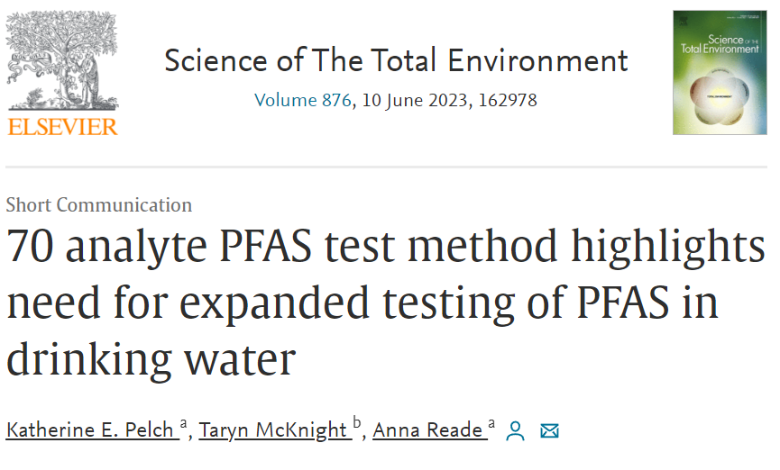
Study Indicates UCMR5 may underestimate PFAS occurrence
Highlights
•Detected PFAS in 30 of 44 DW samples
•Found 26 unique PFAS, including 12 not covered by EPA DW methods
•Ultrashort chain PFPrA detected in most samples with PFAS
•UCMR5 reporting requirements predicted to underreport PFAS
https://doi.org/10.1016/j.scitotenv.2023.162978
Notes:
In contrast to these updates, there are many PFAS available for analysis beyond the 29 compounds included in UCMR5. With that in mind, NRDC initiated a nationwide study to assess the DW of impacted communities and found detections for 12 PFAS not captured by either of the existing DW methods and this UCMR5.
Unfortunately these regulatory statues are struggling to keep up with the rapid advancements being made in the PFAS space. For context, it took the agency 10 years to go from monitoring for 6 PFAS in DW to 29 PFAS in DW, but the technology for doing this much and more existed more than five years ago.
When you look at how lengthy the process is for the EPA to regulated chemicals in DW, or how long it takes to develop and validate methods to test for these chemicals it is hard to imagine how they will keep up with the pace at which the concern over PFAS is increasing and the pressure from legislatures is mounting.

Slide 18
Drinking Water Contaminants Candidate List “CCL5”
Proposals for contaminants for consideration are submitted
Contaminants are selected for the CCL and published every five years
EPA must make regulatory determinations for at least five contaminants listed on the CCL every five years
For the purposes of CCL 5, the structural definition of per- and polyfluoroalkyl substances (PFAS) includes chemicals that contain at least one of these three structures:
(1) R-(CF2)-CF(R′)R″, where both the CF2 and CF moieties are saturated carbons, and none of the R groups can be hydrogen.
(2) R-CF2OCF2-R′, where both the CF2 moieties are saturated carbons, and none of the R groups can be hydrogen.
(3) CF3C(CF3)RR′, where all the carbons are saturated, and none of the R groups can be hydrogen.
EPA is also providing a list of PFAS that meet the CCL 5 structural definition on its CompTox dashboard(https://comptox.epa.gov/dashboard/chemical-lists).
https://www.regulations.gov/document/EPA-HQ-OW-2018-0594-0106
18
Notes:
On that note, let’s take a look at where DW standards really begin.
The US EPA published the Fifth Contaminants Candidate List late last year where we see something new regarding PFAS.
The way the CCL works is , proposals for contaminants for consideration are submitted by the scientific community.
Then, in accordance with the SDWA the EPA publishes the Contaminant Candidate List (CCL) every five years.
Often the contaminates selected for monitoring under the UCMR come from the CCL.
Then if the EPA makes a determination to regulate a contaminant, the agency will initiate the process to propose an NPDWR like they have just done for PFOA and PFOS.
What is most remarkable about the current CCL 5 is that it lists PFAS as a “class” of chemicals.
This was the first time we saw the Agency lay the policy foundation for treating PFAS as a class.
Again, the importance of the definition of what constitutes a PFAS presents itself here. I’ve included the definition EPA used for this particular listing which does not match the other definitions they have used.
Anyways, this means the next time they select contaminants for monitoring under UCMR6 it is possible they could select PFAS as a class rather than trying to play catch up with adding whatever compounds they have expanded their DW methods to capture.

Slide 19
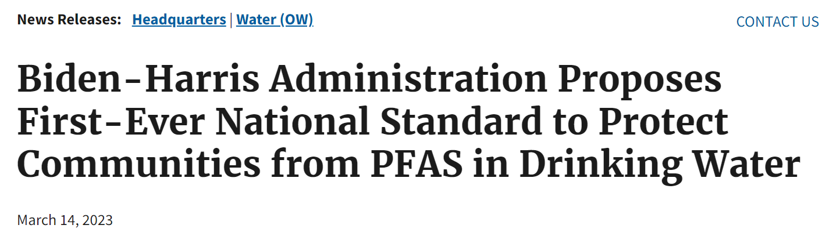
PFAS Maximum Contaminant Levels (MCLs)
National Primary Drinking Water Regulation for PFOA & PFOS
SDWA MCLs
PFOA and PFOS: EPA is proposing to regulate PFOA and PFOS at a level they can be reliably measured at 4 parts per trillion.
PFNA, PFHxS, PFBS, and GenX Chemicals: EPA is also proposing a regulation to limit any mixture containing one or more of PFNA, PFHxS, PFBS, and/or GenX Chemicals using a hazard index calculation, defined in the proposed rule, to determine if the combined levels of these PFAS pose a potential risk.
19
https://www.epa.gov/newsreleases/biden-harris-administration-proposes-first-ever-national-standard-protect-communities
Notes:
Now looking at the other end of that process, we have the end result or almost end result, which is the proposal of a National Primary Drinking Water Regulation, in this case for PFOA and PFOS. The final rule was originally listed for final adoption in Sept of 2024 but in the EPA’s latest update to their Unified Agenda this fall, they now have this listed for Jan 2024, and that is after receiving over 120K public comments. Even with that, all officials continue to state that the final rule will be out before the end of the year. That may be ambitious though, as of last week, OMB had yet to begin review of the final rule. In an case, it is just around the corner.
This rule has a straightforward limit of 4ppt or ng/L listed for PFOA and PFOS but it also includes a hazard index approach for a handful of other compounds.

Slide 20
Hazard Index Calculation
Divide the measured concentration of Gen X by the health-based value of 10 ppt
Divide the measured concentration of PFBS by the health-based value of 2000 ppt
Divide the measured concentration of PFNA by the health-based value of 10 ppt
Divide the measured concentration of PFHxS by the health-based value of 9 ppt
EQUATION:
H.I. = (GenX / 10ppt) + (PFBS / 2000ppt) + (PFNA / 10ppt) + (PFHxS / 9.0ppt)
To determine H.I. compliance, repeat all calculations for each sample collected in the past year for that entry point and calculate the average H.I. for all samples taken in that year.
If the running annual average H.I. is greater than 1.0, it is a violation of the
proposed H.I. MCL.
Notes:
For those wondering about the HI approach and the potential for exceedances, here is the basis for that calculation.
This all depends on how low the health advisories are, and remember the health advisories are based off of the toxicology and not necessarily what is technically feasible. For example, EPA just released it’s tox assessment for PFDA. This is a long chain perfluorinated chemical, longer than PFOA and PFOS so no surprise that the RfD is similarly extremely low. Although EPA has yet to publish a health advisory for this compound, if they do, it could be in the very low ppt or even sub-ppt range. If this were added to the hazard index it would have a significant impact on exceeding this threshold.
Just to put this into context for you, looking at the limits we have here, if any two of GenX, PFNA and PFHxS are detected at 5ppt or higher, the HI will be exceeded. 5ppt is a pretty trace level.

Slide 21
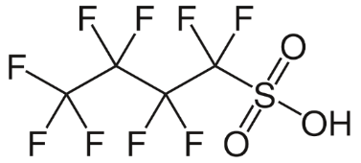
TOXICITY ASSESSMENTS
PFBA
RfD (mg/kg-day) = 1x10⁻³ (Chronic)
PFHxA
Animal Studies
Hazard Characterization
RfD (mg/kg-day) = 5x10⁻⁴ (Chronic)
Human Studies
Physical Properties
PFDAFY24
Step 5 - Revise Assessment
~RfD (mg/kg-day) = 4x10⁻¹⁰ (Chronic)
PFHxSTBD
Step 4 – External Peer Review
Derivation of Reference Doses
PFNATBD
Step 3 – Interagency Science Review
https://www.epa.gov/system/files/documents/2023-10/iris_program_outlook_oct2023.pd
Notes:
Most of our regulatory efforts to establish limits for PFAS, includes not only occurrence data like what we obtain from the Unregulated Contaminants Monitoring Rule (UCMR) but also toxicity data.
EPA uses RSLs to determine whether a removal action or further investigation is needed to protect the environment, human health, and communities, so the creation of RSLs for PFAS compounds provides a clear path for the evaluation of certain PFAS compounds as part of site cleanup actions.
To that end, the EPA continues to chip away at Toxicity Assessments for additional PFAS.
We have a recently established Health Advisory Limits for PFBS and HFPO-DA. These were both replacement chemicals for their longer chain counterparts, PFOS and PFOA.
The assessment of the PFAS listed are in various stages but we do have final RfDs or draft RfDs for some.
EXPANDED CONTENT
For comparison…
PFBA final 1,000 ng/kg/day
PFHxA draft was 500 ng/kg/day
GenX final 3 ng/kg/day
PFBS 300 ng/kg/day
PFOA 0.0015 ng/kg/day (in the earlier doc, not the latest - sorry, still catching up!)
PFOS 0.0079 ng/kg/day (in the earlier doc, not the latest - sorry, still catching up!)
I'm not surprised that the RfD for PFDA is very low, much like that of PFOA and PFOS given that this is an even longer chain chemical, which I would presume would be more bioaccumulative. Based on the studies in PFAS-Tox Database, there's a pretty large evidence base to pull studies from as well.

Slide 22
SUPERFUND
& WASTE
Notes:
Then we have everyone’s favorite heavy hitters, CERLCA and RCRA…

Slide 23
CERCLA Hazardous Substances
EPA Takes Steps to Designate PFOA and PFOS as Hazardous Substances Under CERCLA
“CERCLA does not impose liability on manufacturers of hazardous substances, potentially leaving water suppliers, landfill owners, local fire departments, farmers, and other municipal entities to bear the entire costs associated with investigation and remediation of PFAS contamination.”
Notice of proposed rule making published in 40CFR Part 302, Sept 6, 2022. 60-day comment period closed
Implications include cleanup actions, cost recovery, re-open closed sites, ASTM Phase I AAI
EPA-HQ-OLEM-2019-0341
Notes:
Conversely, their timeline for finalizing the rule designating PFOA and PFOS as hazardous substances has slipped from Aug 2023 to Feb 2024.
This is just my own personal speculation, but I wonder if this has to do with the Advance Notice of Proposed Rulemaking they published seeking comment on whether to designate additional PFAS as HS or even groups of PFAS or PFAS as a class. I know I sound like a broken record, but again the definition of what constitutes a PFAS could have enormous implications if addressed under CERCLA.
Of course, under CERCLA even closed sites can be re-opened and as remarked by an agency official last month, the EPA likely will do so on a case by case basis. EPA has already identified nearly 200 Superfund sites where PFAS are present, and is applying its risk assessment guidance to the chemicals.
EXPANDED CONTENT
On Sept 6, 2022 EPA submitted a proposed rule to designate PFOA and PFOS as hazardous substances under CERCLA to OMB (the Office of Management and Budget) for review.
EPA still has this rule listed with a final date of August 2023.
The most significant implications of such a listing would be the related cleanup actions.
Analytical testing for the proposed designation as it stands right now, would simply be achieved using EPA Draft Method 1633 as the compounds and matrices required for testing are all covered by this method.
However, EPA has issued an Advance Notice of Proposed Rulemaking to seek public input on whether to designate other PFAS, including PFAS as a class of compounds. This goes back to my opening slide about what constitutes a PFAS and how we will demonstrate compliance with this. We’ll talk a little bit later on about the challenges of analyzing for PFAS as a class.

Slide 24
HAZARDOUS CONSTITUENTS - RCRA
If existing data for the four PFAS constituents support listing any or all as RCRA hazardous constituents, EPA will propose to list the constituents in the Federal Register for public comment
PFOA
PFOS
In response to a petition from NM Gov. EPA is evaluating the existing toxicity and health effects data on four PFAS to determine if they should be listed as RCRA Hazardous Constituents
Those chemicals listed are subject to corrective action requirements under RCRA at hazardous waste treatment, storage, and disposal facilities.
PFBS
GenX
https://www.epa.gov/newsreleases/epa-responds-new-mexico-governor-and-acts-address-pfas-under-hazardous-waste-law
https://www.jdsupra.com/legalnews/epa-announces-plans-for-waste-rules-3519848/
Notes:
Another update from the EPA’s Unified Agenda, they provided an official date with a Notice of Proposed Rulemaking expected in August 2023 to designate PFOA, PFOS, PFBS and HFPO-DA as Hazardous Constituents under RCRA but they have since missed that goal.
Those chemicals listed would be subject to corrective action at hazardous waste treatment, storage and disposal facilities.
Once listed as a RCRA hazardous waste, the waste is also considered a hazardous substance under CERCLA so I guess we wait to see which ones transpires first.
And if these were to be listed as hazardous air pollutants that would also automatically list them as hazardous substances under CERCLA,
so lots of pathways here to these designations that have far reaching implications on cleanup and liability.

Slide 25
EPA PFAS Destruction Guidance
Expected December 2023
Will address utilization of analytical tools for demonstration of mineralization of PFAS
https://www.epa.gov/system/files/documents/2023-01/11143_ELG%20Plan%2015_508.pdf#page=48
https://www.epa.gov/system/files/documents/2023-01/11143_ELG%20Plan%2015_508.pdf
Notes:
EPA is also racing to meet a congressional deadline for publishing an update to their PFAS destruction and disposal guidance.
It is expected by the end of the year as well.
They have stated that the finalized guidance will address analytical tools for demonstrating successful mineralization of PFAS and some guidance on how these tools could be used.

Slide 26
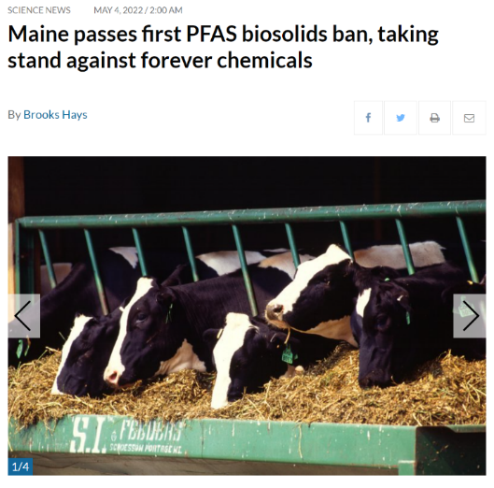
EPA RESEARCH
BIOSOLIDS
The EPA expects to complete a risk assessment of PFOA and PFOS in biosolids by the winter of 2024 to determine if regulations are needed
https://www.epa.gov/biosolids/risk-assessment-pollutants-biosolids#:~:text=The%20Biosolids%20Program%20has%20developed,chemicals%20that%20fail%20the%20screen.
https://www.epa.gov/pfas/pfas-strategic-roadmap-epas-commitments-action-2021-2024
26
Notes:
One area where there seems to be a little disconnect between state and federal priorities is on biosolids.
The PFAS Roadmap has the following listed: The EPA expects to complete a risk assessment of PFAS in biosolids by the winter of 2024 to determine if regulations are needed, and this will only apply to PFOA and PFOS.
States are struggling right now with whether to restrict land applications of biosolids, what limits are appropriate to use and if biosolids are in fact impacting the food supply.
So the EPA’s water office chief, Environmental Council of the States (ECOS) and National Association of State Departments of Agriculture (NASDA) all are partnering to tackle the issue.
And in October the administrator pledged to work with these groups to preserve the three management methods -- land application, incineration and landfilling while protecting human health which EPA estimates that in 2021, large facilities land applied 43 percent of their biosolids, while they landfilled 42 percent and incinerated 14 percent.

Slide 27
EPA PFAS Destruction Guidance
Expected December 2023
Will address utilization of analytical tools for demonstration of mineralization of PFAS
https://www.epa.gov/system/files/documents/2023-01/11143_ELG%20Plan%2015_508.pdf#page=48
https://www.epa.gov/system/files/documents/2023-01/11143_ELG%20Plan%2015_508.pdf
Notes:
Lastly, I just wanted to close out the regulatory landscape with a reminder that EPA is racing to meet a congressional deadline for publishing an update to their PFAS destruction guidance and what that means for us.
They have stated that the finalized guidance will address analytical tools for demonstrating successful mineralization of PFAS and some guidance on how these tools could be used. I will talk a little more about this as well.

Slide 28
METHODS OVERVIEW & UPDATES
Notes:
Now let’s dive into the methods overview and updates.

Slide 29
What Are The Data Being Used For?
Driven by regulatory framework
Defensible data that can withstand legal scrutiny
Compliance
Litigation
WHERE TO BEGIN
Due Diligence
Measure the efficacy of the process
Risk tolerance and mitigating Risk associated with unknowns
Treatment
Notes:
We always need to start by answering the question, what are the data being used for? Whether the data are being used for compliance, due diligence, litigation, or measuring the efficacy of treatment, these all carry different considerations.
And this has, perhaps, never been truer than with PFAS.
Given the lack of clear regulation and agency guidance, we are left having to make a lot of site or program specific decisions with guesstimates about what will be needed from a compliance standpoint in the future, from a liability standpoint, or from the perspective of what the public concern will be.
And for those attorneys out there, you will of course always want to consider whether the data are protected or not before ever deciding to generate them.
We tend to gravitate to one size fits all solutions to these problems, but they really don’t exist for PFAS, at least not at this time.

Slide 30
Comprehensive PFAS Testing
Human Serum
Whole Blood
At-Home Test Kit
Wastewater
Landfill leachate
Biosolids
Sludge
Drinking Water
Surface water
Groundwater
Fish Tissue
Source Air
Ambient Air
Indoor Air
Dispersions
AFFF Product
AFFF Impacted
Media
Soils
Sediment
Vegetation
Food Contact
Material
Textiles
Cosmetics
Artificial Turf
Electronics
Food Supply
Dairy
Vegetables
Fruit
Notes:
I wanted to set the stage with just how comprehensive and extensive the testing efforts are to identify PFAS in the environment, in humans and in products.
This graphic shows you the breadth of matrices being characterized.
This includes:
Wastewater, groundwater, soil, landfill leachate, biosolids, tissues and air. Of course a range of product testing such as AFFF, packaging, textiles and more.
Whether you are trying to assist a manufacturer in auditing their supply chain,
Looking to comply with environmental regulations,
or evaluating treatment technologies,
characterizing this wide range of matrices may come into play.
And what you want to get out of the dataset is likely to vary as well.

Slide 31
Where to Begin?
A mountain of questions when addressing the mostly unknown
WHAT WILL THE DATA BE USED FOR
Developing a Conceptual Site Model
Determining the extent of contamination
Investigating sources of contamination
Assessing human health impacts
Implementing a remediation plan
31
Notes:
Before we dive into the details around available tools and technologies, I just want to acknowledge there is a plethora of analytical options and approaches out there, and each with their own benefits and compromises.
When we talk about PFAS investigations we are largely operating in a world of unknowns still.
When facing this mountain of questions, we start by prioritizing what we want to get out of the dataset and of course what kind of budget there is to spend on answering these questions. Most site investigations are not research projects but sometimes they are.
So where do we begin?

Slide 32
CONVENTIONAL TOOLS
EPA Methods
EPA 537.1
EPA 533
EPA 8327
EPA Draft 1633
TARGETED ANALYSIS
The analysis of specific target analytes with known CAS numbers and analytical reference standards
EPA Standard Methods
ASTM or ISO Methods
User-Defined Methods
Regulatory derived target analyte lists
Laboratory/Client derived target analyte lists
User-defined Methods
“537 Modified”
Laboratory SOP
Notes:
In most cases we tend to begin with our conventional tools.
These are broadly categorized as Targeted Analyses.
This is the analysis of specific target analytes with known CAS#s and analytical reference standards.
We have two EPA standard methods for PFAS in DW, 537.1 and 533.
As of more recently, we have two EPA methods for all the non-DW matrices, EPA 8327 and Draft Method 1633.
But for many years the bulk of the site investigations conducted have depended upon user-defined methods.
These are often referred to as 537 Modified or perhaps a laboratory’s SOP number.
All of which, have limited lists of target analytes available under them, let’s say under 100 compounds.

Slide 33
EPA METHODS
EPA Draft Method In Progress
Final Expected December 2023
EPA Draft 1633
Targeted Analysis of 40 PFAS
Non-Potable Water, Soil & Tissue
LCMSMS, WAX SPE, Isotope Dilution
Multi-Lab Validation Underway
https://www.epa.gov/cwa-methods/cwa-analytical-methods-and-polyfluorinated-alkyl-substances-pfas
33
Notes:
In the U.S. most of our work is still supported by our 537M method but slowly but surely will transition to Draft 1633.
Taking a closer look at Draft Method 1633, this method is specifically for PFAS analysis in NPW, Solids, Biosolids and Tissues.
This is a targeted analysis for 40 PFAS compounds and fundamentally aligns with the user-defined methods that have been the basis for PFAS testing to date, so we expect a certain degree of comparability in the data sets as we transition from one method to the other, but at a significant cost.

Slide 34
LCMSMS/GCMSMS Analysis
Compounds Included in EPA Draft 1633 (RLs = 2-5ng/L) |  | Target Compounds Not Part of EPA Draft 1633 (RLs = 2-5ng/L)
Perfluorobutanoic acid (PFBA) | NEtFOSA | 10:2 FTS | PEPA
Perfluoropentanoic acid (PFPeA) | NMeFOSA | 6:2 FTCA | MTP
Perfluorohexanoic acid (PFHxA) | NMeFOSAA | 8:2 FTCA | PS Acid
Perfluoroheptanoic acid (PFHpA) | NEtFOSAA | 10:2 FTCA | Hydro-PS Acid
Perfluorooctanoic acid (PFOA) | NMeFOSE | 6:2 FTUCA | R-PSDA
Perfluorononanoic acid (PFNA) | NEtFOSE | 8:2 FTUCA | Hydrolyzed PSDA
Perfluorodecanoic acid (PFDA) | 4:2 FTS | 10:2 FTUCA | R-PSDCA
Perfluoroundecanoic acid (PFUnA) | 6:2 FTS | PFECHS | 6:2 diPAP
Perfluorododecanoic acid (PFDoA) | 8:2 FTS | PFPrS | 8:2 diPAP
Perfluorotridecanoic acid (PFTriA) | 9Cl-PF3ONS | PFPrA | 6:2/8:2 diPAP
Perfluorotetradecanoic acid (PFTeA) | 11Cl-PF3OUdS | PFMOAA | 12:2 FTOH
Perfluorobutanesulfonic acid (PFBS) | DONA | PFECAG | 10:2 FTOH
Perfluoropentanesulfonic acid (PFPeS) | HFPO-DA (GenX) | PFO4DA | 8:2 FTOH
Perfluorohexanesulfonic acid (PFHxS) | 3:3 FTCA | PFO3OA | 7:2 FTOH
Perfluoroheptanesulfonic Acid (PFHpS) | 5:3 FTCA | PFO2HxA | 6:2 FTOH
Perfluorooctanesulfonic acid (PFOS) | 7:3 FTCA | R-EVE | 4:2 FTOH
Perfluorononanesulfonic acid (PFNS) | NFDHA | NVHOS | 10:2 FTAc
Perfluorodecanesulfonic acid (PFDS) | PFMBA | Hydro-EVE Acid | 8:2 FTAc
Perfluorododecanesulfonic acid (PFDoS) | PFMPA | Perfluoro-n-octadecanoic acid (PFODA) | 10:2 FTAcr
Perfluorooctanesulfonamide (FOSA) | PFEESA | Perfluoro-n-hexadecanoic acid (PFHxDA) | 8:2 FTAcr
 |  | EVE Acid | 6:2 FTAcr
 |  | PFO5DA | 4:2 FTAcr
 |  | PMPA
Copyright © 2022 Eurofins
Notes:
Right now, we are able to quantify as speciated PFAS compounds these 80 or so that you see here.
On the left you have the Draft 1633 List and, on the right, you have an additional 40 or so compounds that can be captured by 537 Modified methodology along with a special GCMSMS method for the fluorotelomer alcohols.
The expanded list and the FTOHs are user defined methods supported by Eurofins and not many, if any, other commercial labs offer this.

Slide 35
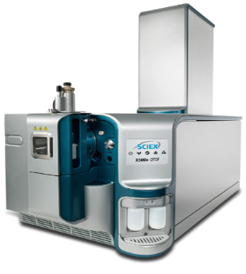
NON-TARGETED ANALYSES
TOP Assay
The analysis of analytes without known CAS numbers or analytical reference standards, or the analysis of a proxy analyte(s)
Eurofins developed some of the first commercial test methods using the TOP Assay, Combustion Ion Chromatography (CIC), and Non-Target Analysis for forensic measurements
Total Oxidizable Precursors
AOF/EOF
Adsorbable Organic Fluorine
Extractable Organic Fluorine
NTA
Non-Target Analysis
Notes:
When we move beyond our conventional tools which was made up of targeted analyses, we find the non-targeted tools.
We have a few different techniques here.

Slide 36
TOP Assay
TOP Assay
(Total Oxidizable Precursors)
TOP Assay
Add hydroxyl radical to ECF C8 Precursors and you will get PFOA
Add hydroxyl radical to Fluorotelomer C8 Precursors and you will get PFOA and C7 and shorter PFCAs
OH•
OH•
PFAA Precursors
PFCAs
85°C
OH•
 | Pre-Treatment | Post-Treatment
PFOA | 13 | 14 | ng/L
PFHxA | 11 | 42 | ng/L
PFPA | 15 | 40 | ng/L
PFHpA | ND | 6.3 | ng/L
PFBA | ND | 46 | ng/L
Total PFCA | 39 | 148.3 | ng/L
Total PFCA Difference |  | 109.3 | ng/L
Notes:
Building upon the standard targeted analysis, we can combine this with a preparation technique that tells us more about the unknown mass of PFAS in the samples. There are certain polyfluorinated or incompletely fluorinated chemicals (most of which we do not capture with a targeted analysis) that have the potential to transform in the environment into the terminal end products that we do measure for. These are the chemicals that make up our risk drivers today, the perfluoroalkyl acids or PFAAs.
The TOP or Total Oxidizable Precursor Assay is an oxidation procedure, combined with the targeted LCMSMS analysis.
With this technique we are able to force the conversion of precursors to their terminal end products instantly in the lab.
This tool is useful for revealing a portion of the dark matter that has the potential to convert to today’s risk drivers. It also has value as a forensics tool.
Another advantage of this technique is that it utilizes our standard targeted method and so the sensitivity is still in that singe digit ppt range.

Slide 37
Total Organic Fluorine (TOF)
TF
CIC
CIC: Combustion Ion Chromatography
AOF
EOF
37
Notes:
When we look to capture more of the unknown mass of PFAS we turn to a Total Organic Fluorine measurement using CIC or combustion ion chromatography.
In order to isolate the organic fluorine in the samples we employ a preparation technique using adsorption for waters or extraction for solids and these data are then reported as AOF or EOF. If we did nothing to the sample and just combusted it as is we would be reporting TF or Total Fluorine. So there really is not any such thing as TOF, it is kind of a misnomer, but it has caught on as the reference for this methodology.
The AOF or EOF methods are the best available technique for a proxy for total PFAS but the representation of “PFAS Only” or “All PFAS” is certainly not foolproof. You could have a low bias from missing the short chains, you could have a high bias from something like fluorinated pesticides or fluorinated pharmaceuticals.
And a caveat with this technique is the sensitivity of just under a ppb, as compared to our risk-based screening levels in single digit ppt.

Slide 38
EPA METHODS
EPA Draft Method for AOF
EPA Draft 1621
Adsorbable Organic Fluorine (AOF)
Proxy analysis for ‘Total PFAS’
Single lab validation complete; multi-lab validation just begun
https://www.epa.gov/cwa-methods/cwa-analytical-methods-and-polyfluorinated-alkyl-substances-pfas
38
Notes:
EPA has released a Draft method for Adsorbable Organic Fluorine or AOF.
Draft method 1621.
This method has just begun the multi-lab validation effort, but the EPA has already begun using it, with our support, in their wastewater monitoring efforts to gather data that will help to inform future Effluent Limitation Guidelines.
This means we will get to see the real-world application of this method maybe even before it gets published.

Slide 39
LC-QToF-MS
Liquid Chromatography
Quadrupole Time of Flight
Mass Spectrometry
Non-Target Analysis
Targeted Analysis
Suspect Screening Analysis
Non-Targeted Analysis
39
Notes:
With the fact that we are operating in a world of mostly unknowns when it comes to PFAS compounds, the ability to test for unknowns, otherwise know as non-targeted analysis, has become very attractive.
It is important to note however, this is a very sophisticated tool,
Not only from the standpoint of generating the data, but maybe more so from the standpoint of interpreting the data.
These are the type of data that would be used in a forensics investigation, or litigation.
EXAPNDED CONTENT
Non-target analysis (NTA) is a technique where we use HRMS (either qTOF or Orbitrap) and the accurate mass determination capabilities to identify unknowns.
Compounds can be tentatively identified against select libraries that consist of thousands of compounds. This is what we refer to as suspect screening and it is largely the space that academics and commercial laboratories operate in.
These data are not fully quantifiable in the way that targeted analyses are.
This is more about identification than reporting a concentration.
And probably the most significant limitation to date has been sensitivity, although it looks like this is about to improve.
Historically, we would not see a strong signal for anything less than 1ppb and our confidence levels were not as strong between 1-10ppb.
So this has been great for fingerprinting a source zone or product but had limited capabilities further downgradient.
With the latest and greatest in instrument technology, it looks like we may be able to detect theses unknowns in the ppt range.
EPA researchers like Mark Strynar and James McCord have utilized this technique extensively, as well as certain academics.
A lot of their research focuses on compound identification, where they have looked to uncover the next generation of replacement chemistries that may have already found their way into our environment.

Slide 40
Targeted PFAS
TOP Assay
All Matrices – ~ 80 PFAS
All Matrices – Precursors
Strengths: Selectivity Sensitivity at ~1-5ppt
Can be used for risk assessment
Weaknesses: Limited list of compounds
Strengths: Sensitivity at ~1-5ppt
Specific to ‘unknowns’ with potential to convert to risk drivers
Weaknesses: Not specific
Does not complete a mass balance
Method Toolbox
Non-Target Analysis
Total Organic Fluorine
All Matrices – Unknowns
All Matrices – Organic Fluorine
Strengths: Ability to identify ‘unknowns’ with specificity
Ability to conduct novel compound identification
Weaknesses: Limited to current libraries
Limited quantitation & sensitivity
Strengths: Closest to a mass balance
Weaknesses: Sensitivity at ~1ppb
No selectivity
Copyright © 2022 Eurofins
Notes:
We know that each of these tools has strengths and weaknesses. We find in many cases, a combination of tools is most valuable, and we are here to help with navigating which tools may be more or less appropriate for your project objectives.
EXPANDED CONTENT
The most conservative approach for capturing as much PFAS as possible, would be to test for an expanded list of targeted compounds in combination with a TOF analysis.
If un-regulated PFAS or a mass of non-discrete PFAS are not important for your site-specific objectives, then a targeted analysis for a standard EPA target list in combination with the TOP Assay might suffice.
If source identification is important, a combination of these tools may prove useful in elucidating key contributors.
If putting a name to a face is important for your project objectives for any of the unknown PFAS, the NTA method can provide this additional level of detail, and although it may not capture the presence of very trace levels of PFAS, this tool could provide confirmation that a few significant PFAS compounds are not the cause of an elevated AOF or TOP Assay result.
And with all of this, remember that method sensitivity and balancing the sensitivity of the tools used, is an important component of representing what is truly present in a sample and therefore the environment.

Slide 41
WASTEWATER STUDY
41
Notes:
So with all of those tools at our disposable, each with their own set of benefits and compromises, we set out to conduct a small internal study to learn more about the utility of these tools when characterizing wastewater and to understand what may be on the horizon in terms of analytical approaches and where EPA is headed with all of this.

Slide 42
WWTP Study
Sample | AOF (ng/L) | TOP Assay – PFCA Difference (ng/L)
Influent | 1,300 | 110
Influent Dup | 1,300 | 120
Effluent | 1,500 | 220
Effluent Dup | 1,100 | 230
∑PFAS 58.6
∑PFAS 145.7
AOF Equivalent for these samples is 63%
Notes:
In particular, I want to draw your attention to why we think the EPA and some of the states intend to broadly use the AOF method when characterizing wastewater.
These results are from a private WWTP and are very reflective of the results we saw across facilities. You can see here with the targeted analysis, we see a handful of PFAS detected, nothing at greater than 35ppt but when we look at the AOF and TOP Assay results we see a significant difference, indicating there are potentially more PFAS present than the targeted analysis can capture.

Slide 43
POTW
Sample | AOF (ng/L) | TOP Assay – PFCA Difference (ng/L)
Influent | 5,200 | 170
Influent Dup | 4,600 | 170
Effluent | 3,100 | 94
Effluent Dup | 1,800 | 85
∑PFAS 54.3
∑PFAS 79.6
Notes:
At one of the POTWs, we have a similar concentration range, but this time several compounds not part of draft method 1633 with 6:2 diPAP being the most prevalent. Without the expanded list you would be missing half the picture here and the most prevalent PFAS.
And again, but an even more significant disparity between the targeted results and the AOF results.
You may have noticed though, the TOP Assay results do not seem to indicate there is anywhere near as much unknown mass of PFAS present as the AOF results do.
These are different tests, and so it is not a one to one comparison, but relatively there is something a miss here.
The reason why I think this is really important to point out, especially for a POTW, is that an AOF number can be biased high by things like fluorinated pesticides and fluorinated pharmaceuticals.
In fact a recent study noted contributions to AOF or EOF results from these traditionally non-PFAS substances can be as high as 29% in wastewater or biosolids.
The TOP assay is not susceptible to these high biases but it is susceptible to a low bias from not capturing all possible PFAS.

Slide 44
WWTP Study Site 4 – Industrial Discharge
Sample | AOF (ng/L) | TOP Assay – PFCA Difference (ng/L)
Dairy Manufacturer, Effluent | 33,000 | 360
Landfill, Effluent | 1400 | 100
44
Notes:
We also tested the discharges of various industrial facilities.
So depending upon the industries you are dealing with this picture can get even worse when you look at the AOF data or an expanded list beyond the Draft 1633 list of 40.
Here you can see what the data looked like from a dairy manufacturer as well as a landfill.
With the Diary facility the targeted results look virtually benign but the AOF result is one of the highest we saw.
The landfill on the other hand looks a lot like what we would have expected.

Slide 45
Site 4 – Industrial Discharge
Sample | AOF (ng/L) | TOP Assay – PFCA Difference (ng/L)
Effluent Commercial Laundry | 39,000 | 6,100
45
Notes:
The commercial laundry was the highest concentrations we saw overall and the widest range of target analytes. Again, you would have missed the three most prevalent with the Draft 1633 approach.
I just wanted you all to have this context as you start to navigate methods beyond the traditional targeted analysis and may get asked about things like AOF or TOP Assay
And to better understand how a combination of these tools can start paint a more complete picture or at least illuminate some of the data gaps.

Slide 46
COMPLEX & EMERGING MATRICES
Notes:
Now let’s touch on a few complex matrix types that have even more special considerations, modifications or techniques associated with them.

Slide 47
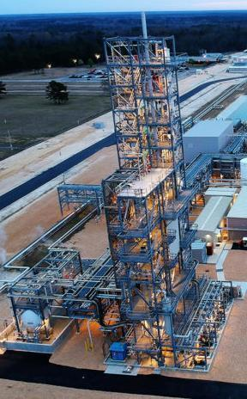
Source Air
Ambient Air
Vapor
EPA OTM-45
EPA OTM-50
EPA OTM-55
Modified
TO-13A / LCMSMS
Modified
TO-17 / GCMSMS
Application: Semivolatile and Particle-bound PFAS in Ambient Air
Collection: PUF/XAD Cartridge based off EPA TO-13A
Sample Preparation: Methanol Extraction, user-defined method
Analysis: User-defined method for PFAS by LCMSMS with Isotope Dilution
Application: Volatile PFAS in Ambient Air and Soil Vapor
Collection: Thermal Desorption (TD) Tube based off EPA TO-17
Sample Preparation: TD based off EPA TO-17
Analysis: User-defined method for PFAS by GCMSMS
Application: Semivolatile/Volatile and Particulate-bound PFAS from Source Air Emissions
Collection: Based off of EPA Method 0010/TO-15
Sample Preparation: Based off EPA 3542
Analysis: LCMSMS with Isotope Dilution/GCMS
Notes:
There are methods that have been modified for PFAS in source air emissions, ambient air, soil vapor and indoor air.
EPA has set out to tackle source air first so they can confirm all of the destruction technologies being developed are in fact destroying PFAS and not creating unintended byproducts, like products of incomplete combustion. For source air, we already have method OTM-45 which was designed to capture the semivolatile and particle bound PFAS we typically test for in waters and soils. Right now they are in the process of finalizing method OTM-50 which targets the ultra short and volatile PFAS that are expected to be those primary products of incomplete combustion.
For ambient air, indoor air and soil vapor, these are currently user-defined methods developed by Eurofins.
Similarly, there are two different approaches and analyses for the semivolatile versus volatile PFAS.

Slide 48
ZCATS Wipe Analysis
Zwitterionic, Cationic, Anionic Total Surfactants
Fluorinated AFFF
Contains mixture of PFAS
ZCATS uses the best available technology to detect additional zwitterionic, cationic, and anionic PFAS on surfaces and containers which previously contained Aqueous Film-Forming Foam (AFFF).
Fluorinated-AFFFs contain a mixture of legacy PFAS, such as PFOS, as well as precursor-PFAS which may breakdown to persistent PFOS and PFOA.
Precursor-PFAS are a chemically diverse mixture of zwitterionic, cationic, and anionic compounds (Backe, 2013), most of which cannot be analyzed by traditional targeted analyses like EPA Draft Method 1633.
Targeted Analysis
Limited to Anions
Broad Range of PFAS
Zwitterionic, Cationic, Anionic
Surface Wipe Test
State-of-the-art
Notes:
ZCATS is a state-of-the-art surface wipe test for a broad range of Per and Polyfluoroalkyl Substances (PFAS) on non-porous surfaces developed in collaboration with Dr. Ian Ross at Tetra Tech. ZCATS uses the best available technology to detect additional zwitterionic, cationic, and anionic PFAS on surfaces and containers which previously contained Aqueous Film-Forming Foam (AFFF).
Fluorinated-AFFFs contain a mixture of legacy PFAS, such as PFOS, as well as precursor-PFAS which may breakdown to persistent PFOS and PFOA. Precursor-PFAS are a chemically diverse mixture of zwitterionic, cationic, and anionic compounds, most of which cannot be analyzed by traditional targeted analyses like EPA Draft Method 1633.
ZCATS uses the best available technology to detect PFAS that may be present on surfaces. It covers a variety of PFAS using a triple wipe approach for collection, a sequential extraction (Nickerson, 2021), and the Total Oxidizable Precursor (TOP) Assay (Houtz, 2012) to breakdown precursor-PFAS into detectable analogues.
As the industry moves to lower and lower human health risk limits, the verification of decontamination procedures is essential. This test may help to understand the degree of the residual PFAS on surfaces. As the industry moves to Fluorine Free Foam alternatives, any residual PFAS may either leach out over time or degrade into legacy PFAS, which could exceed limits.

Slide 49
PFAS in Whole Blood
Eurofins Sacramento Pioneers First Method In The World For PFAS In Whole Blood
PFAS analysis from a single drop of blood, sampled by the end user via a self-collection VAMS device
49
Notes:
As the public concern about exposure to PFAS grows the technology on this front needed to evolve as well.
Now industry, health departments, researchers, or private citizens can deploy self-collection blood kits to capture a much more comprehensive list of PFAS compounds in whole blood than has ever been achieved before, and at still very low reporting limits.
Samples are collected via a finger prick requiring minimal sample volumes and shipped via regular mail.

Slide 50
PFAS Practice Leader
Taryn.McKnight@ET.EurofinsUS.com
916-347-6815
Taryn McKnight
50
Notes:
Thank you so much for your time and please feel free to reach out to me at the contact info provided if you have any questions for me.

